Slide 1

COAST GUARD KINDERGARTEN
WELCOMES
MRS SAVVITAA RAJAPUTHRAN
PRESIDENT, TATRAKSHIKA (A & N)

Slide 2
SCOPE
INTRODUCTION
SCHOOL GOVERNING BODY AND MANAGEMENT COMMITTEE
DETAILS OF SCHOOL STAFF
CLASS / SECTIONWISE DETAILS
ASSETS AND FACILITIES
SCHOOL FUNCTIONING DURING COVID PERIOD
SCHEDULE OF EVENTS
PHOTO GALLERY
STUDENTS’ PERFORMANCES

Slide 3
INTRODUCTION
SCHOOL MOTTO- EDUCATION FOR EXCELLENCE
CGKG ESTABLISHED IN 1996
STARTED WITH A STRENGTH OF 07 STUDENTS AND 03
STAFF MEMBERS
PRESENT STRENGTH COMPRISES OF 151 STUDENTS
AND 19 STAFF MEMBERS
MEDIUM OF INSTRUCTION IS ENGLISH AND HINDI IS
TAUGHT AS COMPLUSORY LANGUAGE
AMENDED ROUTINES DURING ONGOING PANDEMIC SCENARIO

Slide 4
GOVERNING BODY & MANAGEMENT COMMITTEE CGKG, PORT BLAIR
GOVERNING BODY
PATRON-IN-CHIEF
PATRON
CHAIRMAN
OFFICER I/C
PRINCIPAL
CGWWA EDUCATION MEMBER
MEMBERS FROM RHQ(A&N) AND DHQ-14
MANAGEMENT COMMITTEE
CHAIRMAN
OI/C CGKG
PRINCIPAL
CGWWA EDUCATION MEMBER
MEMBERS FROM RHQ(A&N) AND DHQ-14

Slide 5
DETAILS OF SCHOOL STAFF
HEADMISTRESS | 01
TEACHERS | 07
OFFICE ASST | 02
SAHAYIKAS | 07
PEON | 01
WATCHMAN | 01
SAFAIWALA | 01

Slide 6
CLASS / SECTION-WISE DETAILS
CLASS | SECTIONS | STRENGTH
PLAY GROUP | ONE | 05
NURSERY | TWO | 35
LKG | TWO | 60
UKG | TWO | 51
TOTAL | SEVEN | 151
01 ACTIVITY AND LIBRARY ROOM EACH

Slide 7
SCHOOL FUNCTIONING DURING COVID PERIOD
ONLINE CLASSES CONDUCTED THROUGH GOOGLE MEET
RECORDED LESSONS SHARED ON WHATSAPP FOR THE EASE OF
WORKING PARENTS AND FOR REVISION PURPOSE
ALL ACTIVITIES/COMPETITIONS CONDUCTED THROUGH ONLINE
MODE
FULL CO-OPERATION FROM PARENTS/ GUARDIANS
EXAMS CONDUCTED BY SHARING PDFs.
ALL TEACHERS TRAINED THOROUGHLY TO OPERATE AND
CONDUCT CLASSES THROUGH ONLINE MODE

Slide 8
SCHEDULE OF EVENTS
PLANTATION DAY
RAKSHA BANDHAN
GRAND PARENTS DAY
INDEPENDENCE DAY
EID
ONAM
TEACHERS DAY
GANESH CHATURTHI
GANDHI JAYANTI
DIWALI
CHRISTMAS
ANNUAL DAY
FLOWER SHOW
COLOURS WEEK
REPUBLIC DAY
VISIT TO SCIENCE CENTRE
VISIT TO AIR SQUADRON
SCHOOL PICNIC
HEALTH & NUTRITION WEEK

Slide 9
SCHEDULE OF EVENTS
COMPETITIONS
ENGLISH RECITATION
RAKHI MAKING
HINDI RECITATION
STORY TELLING
DRAWING
CALLIGRAPHY COMPETITION

Slide 10
ASSETS & FACILITIES
CLASS ROOMS | 07
KIDS LIBRARY | 01
ACTIVITY ROOM | 01
PLAY GROUND | 01
COMPUTERS | 04
OVERHEAD PROJECTOR | 01
LCD TV | 01
PA SYSTEM | 01
KENT RO | 01
COOLER | 01
PRINTER / COPIER | 02

Slide 11
PHOTO GALLERY
2020-21

Slide 12
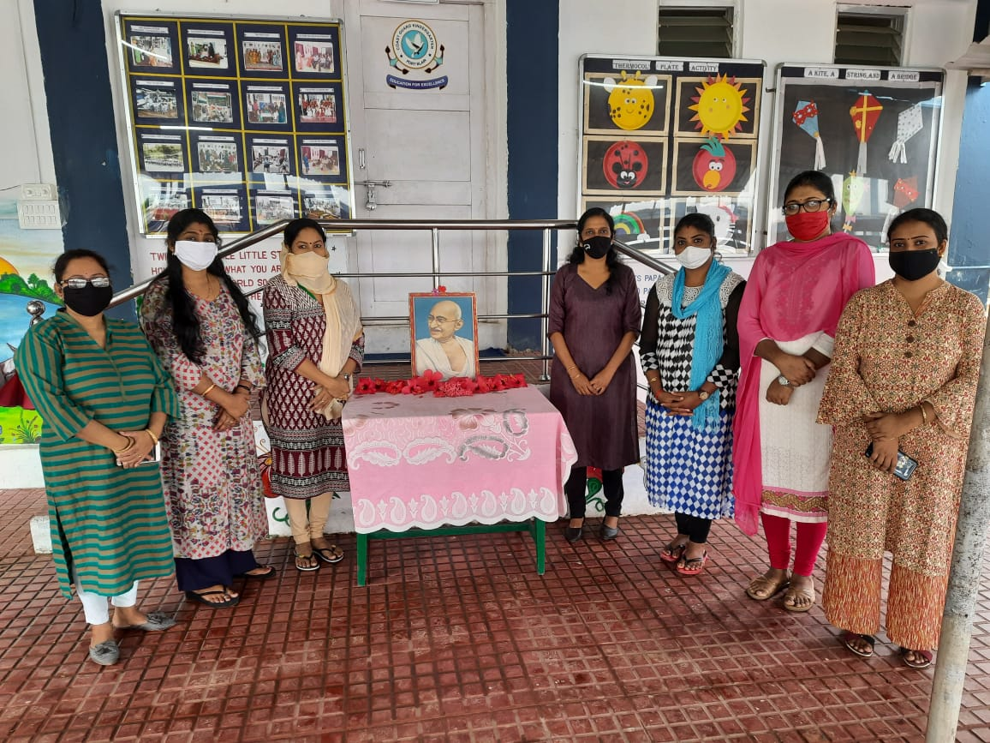
GANDHI JAYANTI 2020

Slide 13
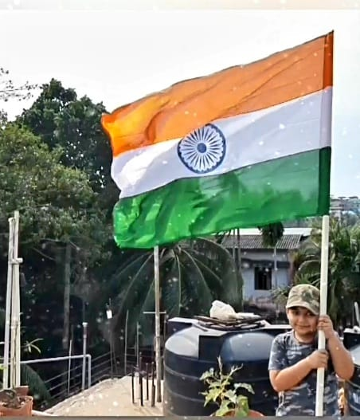
REPUBLIC DAY CELEBRATIONS 2021

Slide 14
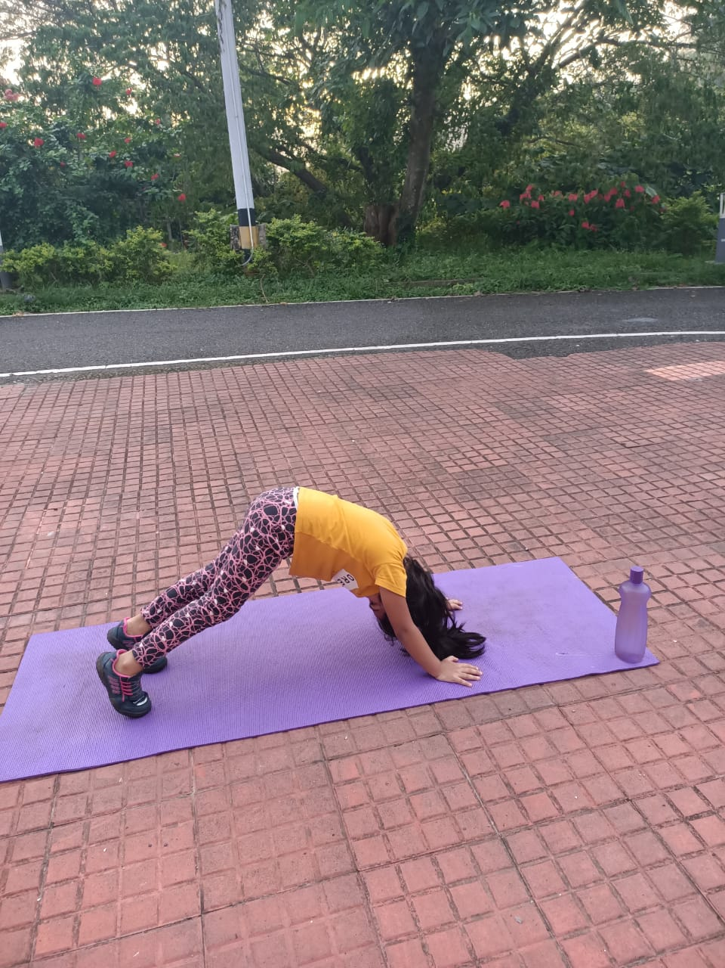
YOGA DAY CELEBRATIONS 2021

Slide 15
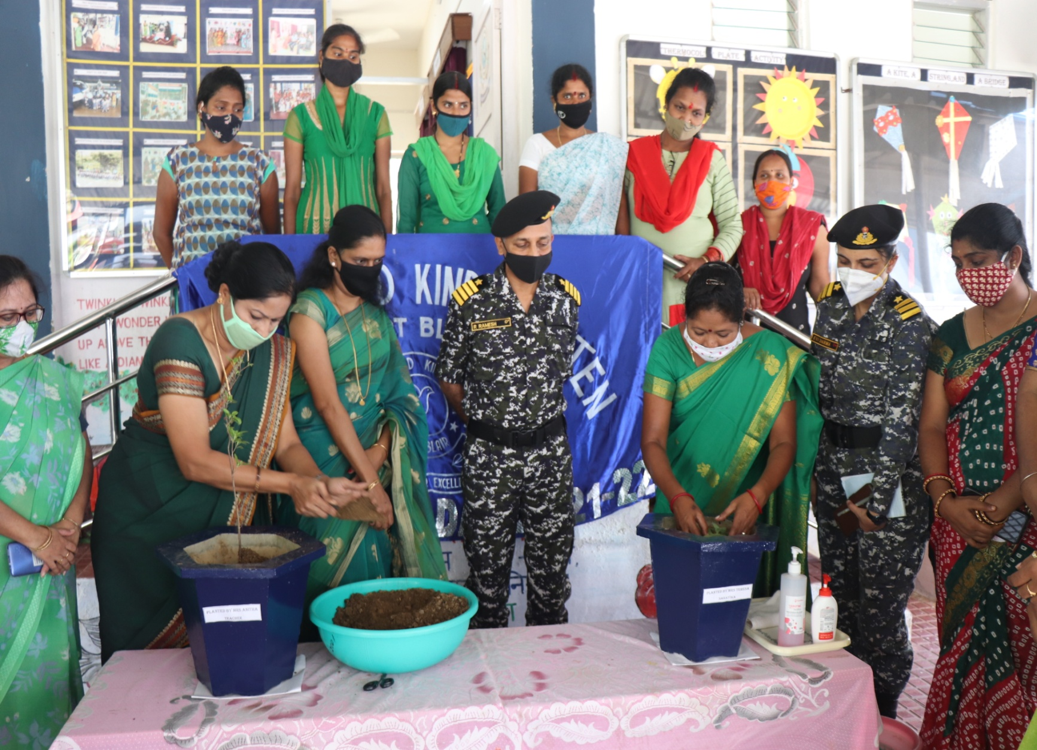
TREE PLANATION AT CGKG

Slide 16
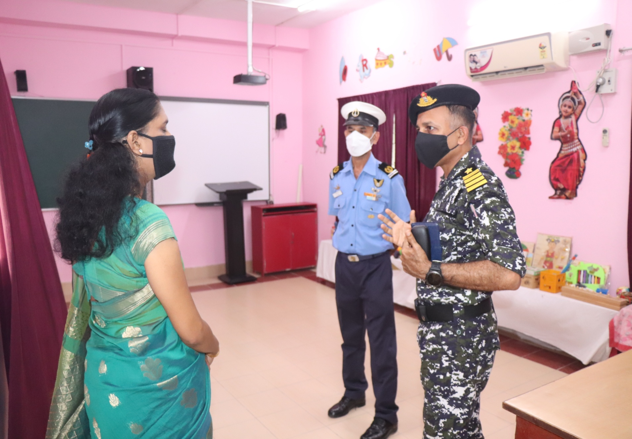
CHAIRMAN’S MAIDEN VISIT TO CGKG

Slide 17
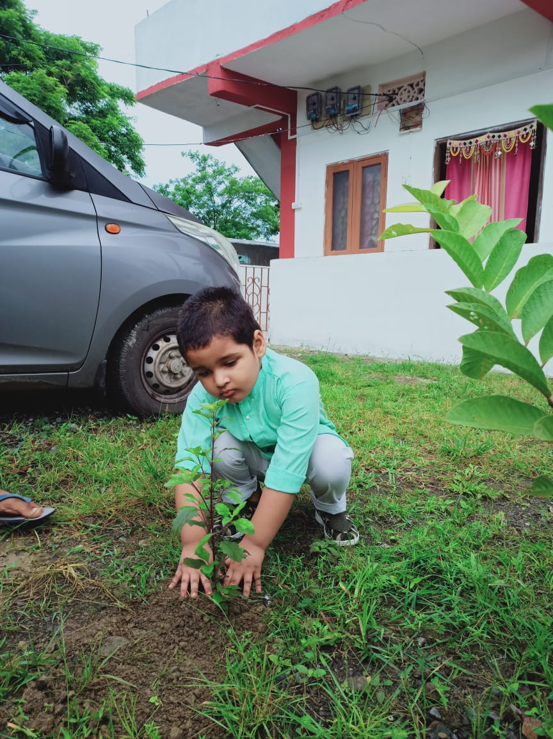
TREE PLANTATION BY STUDENTS AT HOME

Slide 18
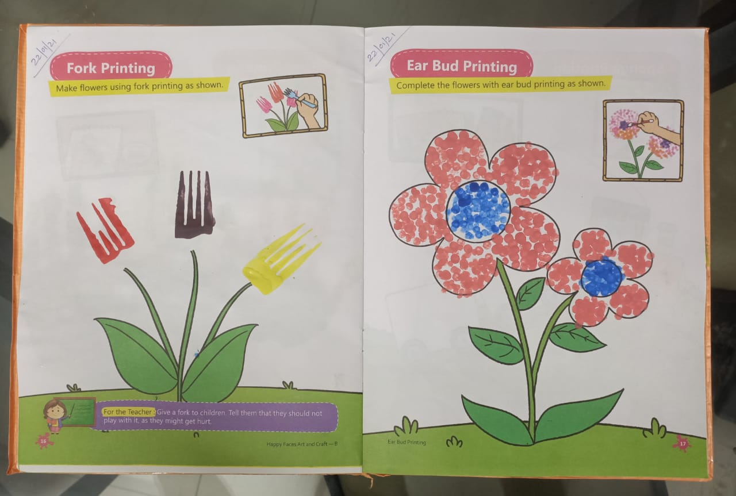
GANDHI JAYANTI 2020

Slide 19
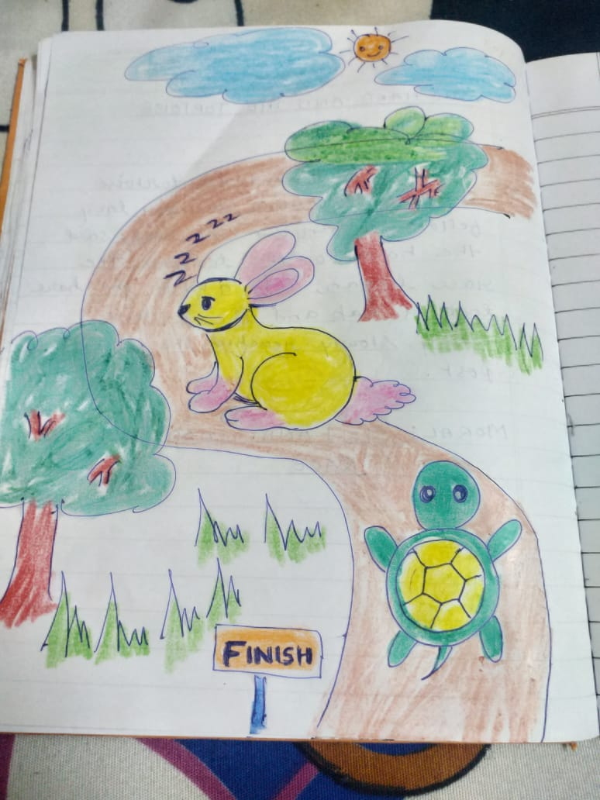
GANDHI JAYANTI 2020

Slide 20
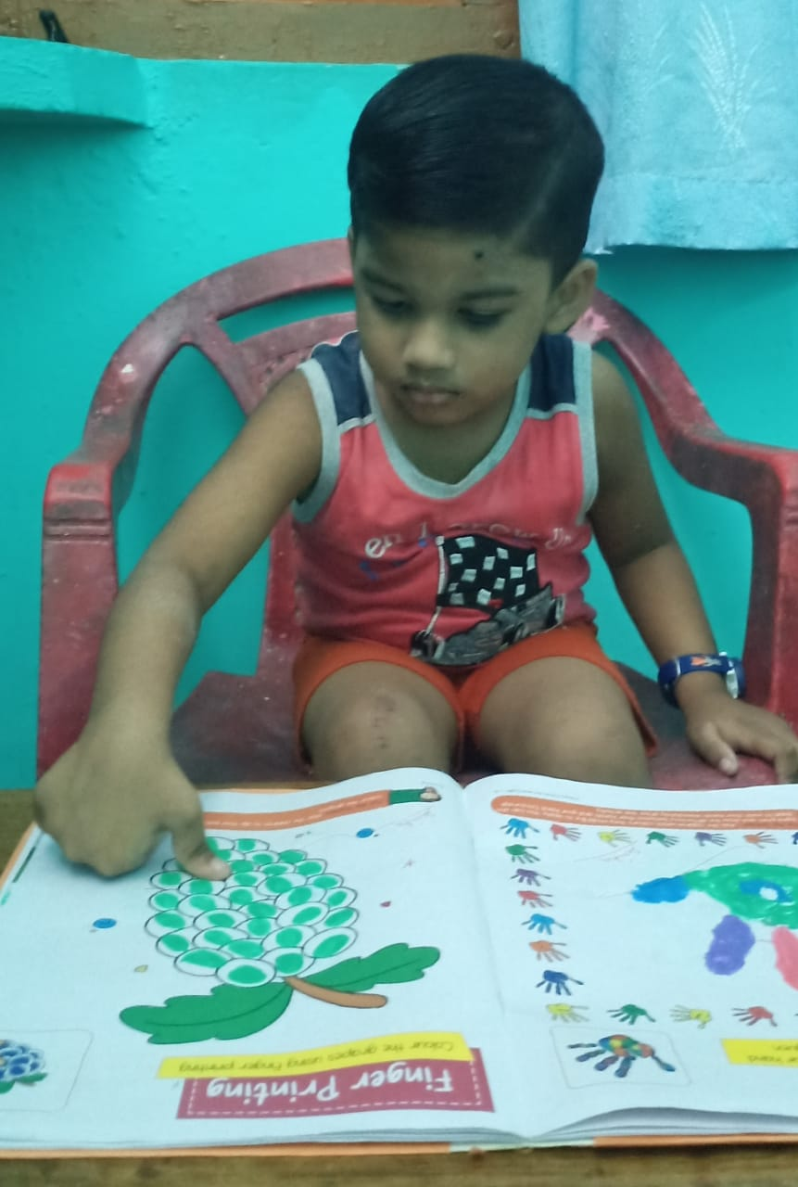
ONLINE ACTIVITY SESSIONS

Slide 21
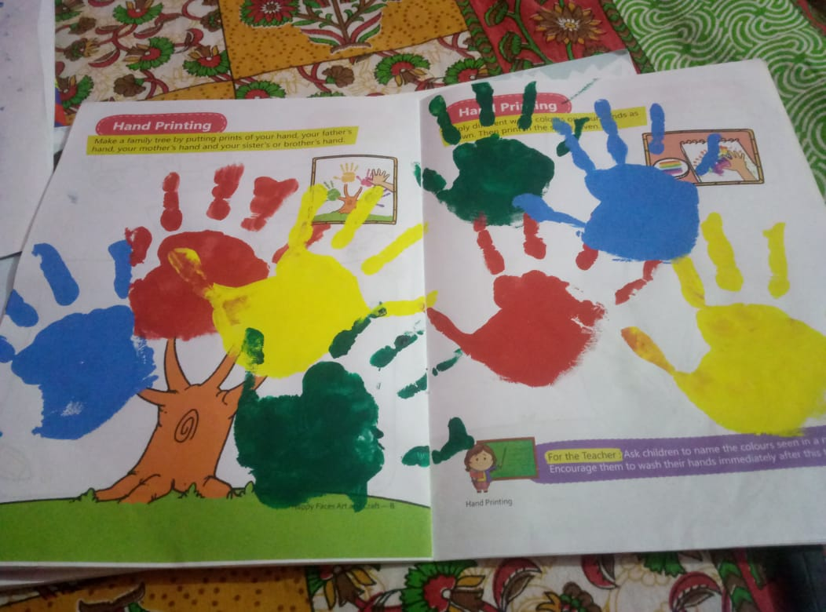
HAND PRINTING ONLINE SESSIONS

Slide 22
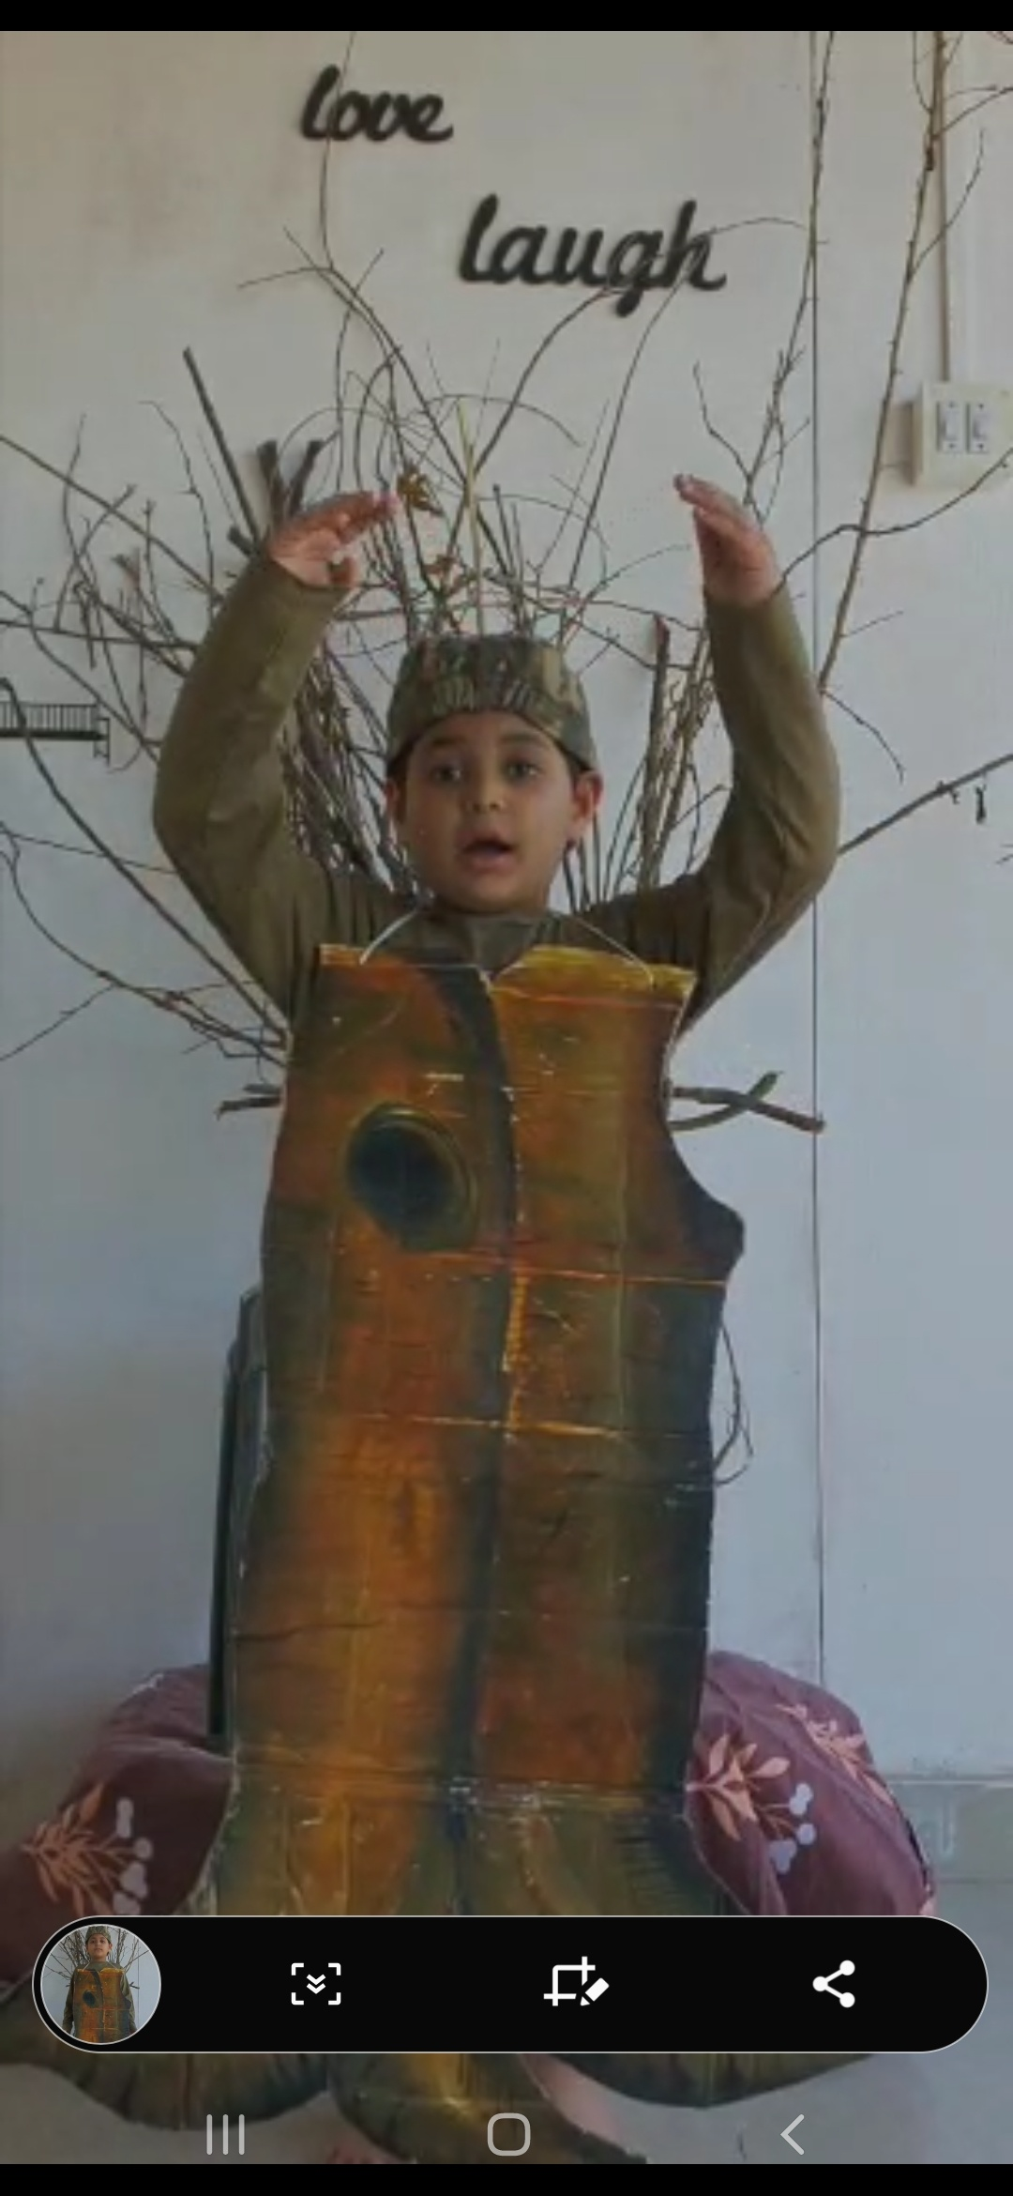
GANDHI JAYANTI 2020

Slide 23
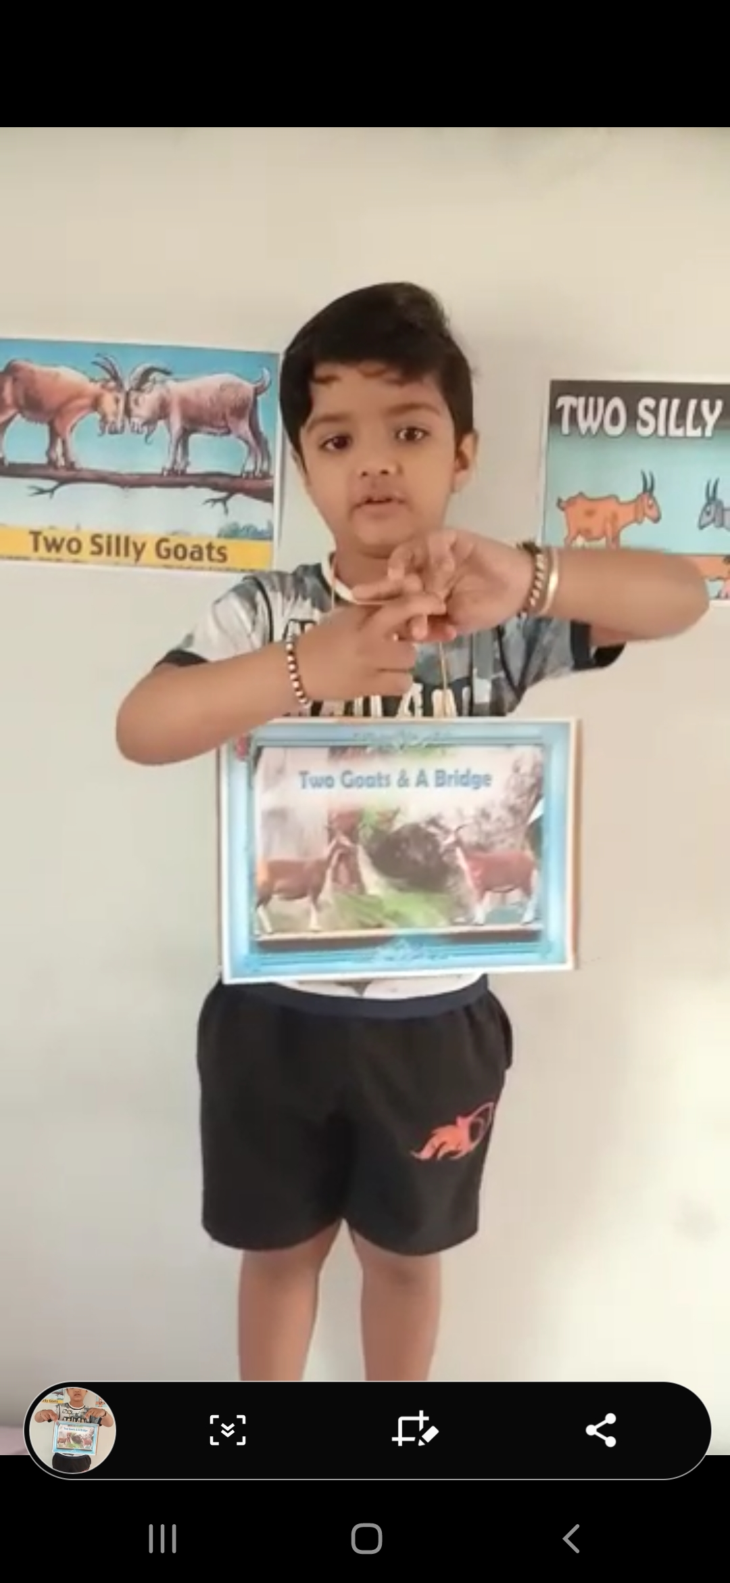
GANDHI JAYANTI 2020

Slide 24
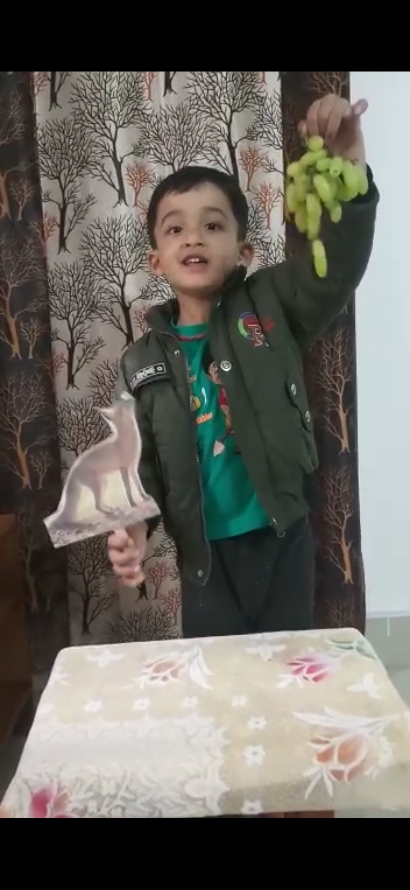
POEM RECITATION COMPETITION

Slide 25
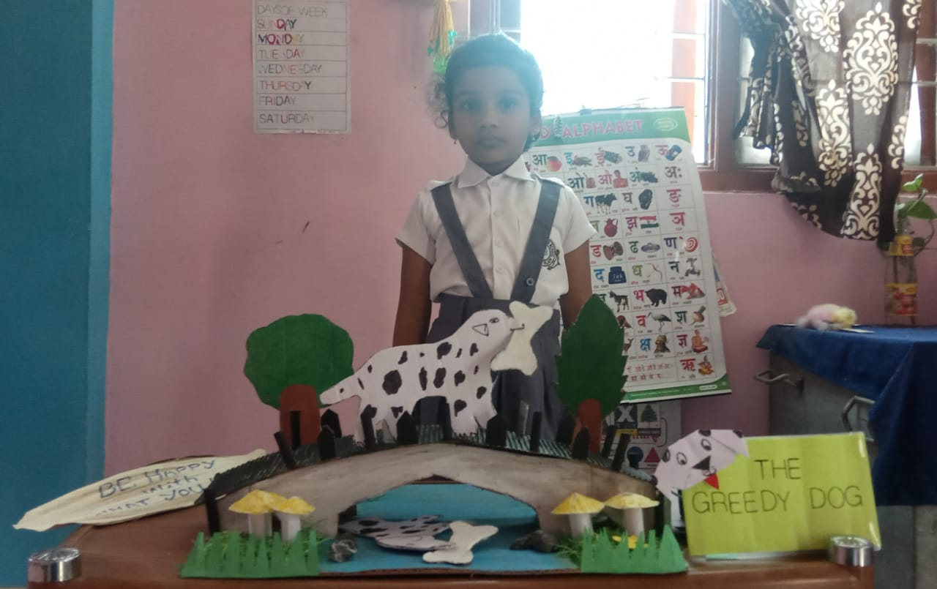
STORY TELLING COMPETITION

Slide 26
STUDENTS’ PERFORMANCES

Slide 27
THANK YOU

